Slide 1
DEPARTMENT OF COMPUTER SCIENCE AND ENGINEERING CMR TECHNICAL CAMPUS 2020-2024 A MINI PROJECT ON FAKE IMAGES DETECTION
PROJECT MEMBERS:
Sayam Akshaya (207R1A05N9)
Ambati Nagender (207R1A05J5)
Pasham Deepthika (207R1A05N3)
under the guidance of :
Najeema Afrin
(Assistant Professor)

Slide 2
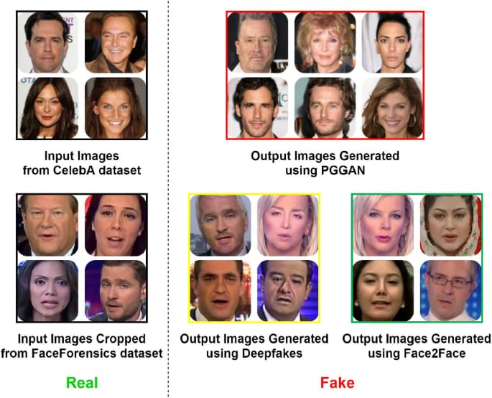
FAKE IMAGES DETECTION

Slide 3
CONTENTS:
Abstract
Existing System
Disadvantages of Existing System
Proposed System
Advantages of Proposed System
Hardware and Software Requirements
Novelty of the project
Architecture
Modules
UML Diagrams
Sample Code
Results
Conclusion
Future Scope
References

Slide 4
ABSTRACT :
In this paper, we investigate whether robust hashing has a possibility to robustly detect fake-images even when multiple manipulation techniques such as JPEG compression are applied to images for the first time. In an experiment, the proposed fake detection with robust hashing is demonstrated to outperform state-of-the-art one under the use of various datasets including fake images generated with GANs.

Slide 5
EXISTING SYSTEM:
Fake images are manually generated by using image editing tools such as Photoshop. Splicing, copy-move, and deletion are also carried out under the use of such a tool. Similarly, resizing, rotating, blurring, and changing the color of an image can be manually carried out. In addition, recent rapid advances in deep image synthesis techniques such as GANs have automatically generated fake images. Cycle GAN and Star GAN are typical image synthesis techniques with GANs. Cycle GAN is a GAN that performs one-to-one transformations, e.g. changing apples to oranges, while Star GAN is a GAN that performs many-to- many transformations, such as changing a person’s facial expression or hair color . Furthermore, fake videos created using deep learning are called Deepfake, and various tampering methods have emerged, such as those using autoencoders, Face2Face

Slide 6
Disadvantages of Existing System:
LESS ACCURACY
LOW EFFICIENCY

Slide 7
Proposed System:
How an overview of the proposed method. In the framework, robust hash value is computed from easy reference image by using a robust hash method, and stored in a database. Similar to reference images, a robust hash value is computed from a query one by using the same hash method. The hash value of the query is compared with those stored the database. Finally, the query image is judged whether it is real or fake in accordance with the distance between two hash values.

Slide 8
Advantages of Proposed System:
HIGH ACCURACY
HIGH EFFICIENCY

Slide 9
Hardware Requirements:
System : i3 or above.
Ram : 4 GB.
Hard Disk : 40 GB
Software Requirements:
Operating system : Windows8 or Above.
Coding Language : python 3.7

Slide 10
Novelty of the project:
There have been several recent advancements in the field of fake images detection. One of the most promising approaches involves using generative models such as Generative Adversarial Networks (GANs) to create synthetic images that are then used to train a detector. Another promising approach is the use of deep learning algorithms that can analyze the subtle differences between real and fake images. These algorithms can detect anomalies in the image data that are indicative of image manipulation, such as inconsistencies in lighting or shadows.
Overall, the field of fake image detection is rapidly evolving, and new advancements are being made all the time. As the technology improves, we can expect to see more sophisticated techniques and tools for detecting and preventing the spread of fake images.

Slide 11
Architecture

Slide 12
Modules
4 Modules are used to run this project
Generate Image Train & Test Model
Upload Test Image
Classify Picture In Images
Exit

Slide 13
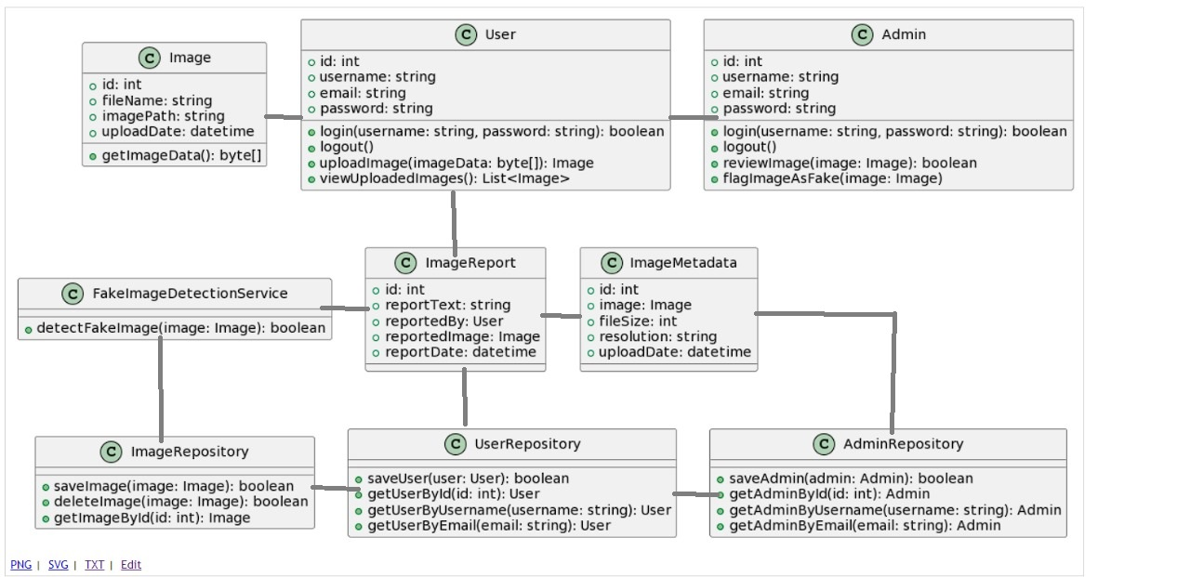
Class Diagram

Slide 14
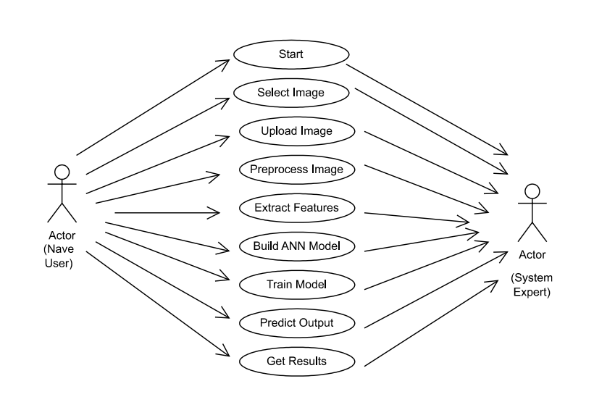
UseCase Diagram

Slide 15
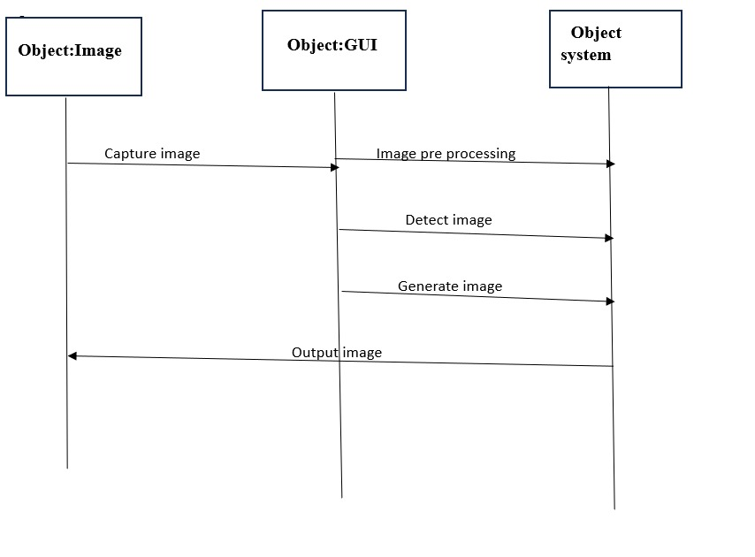
Sequence Diagram

Slide 16
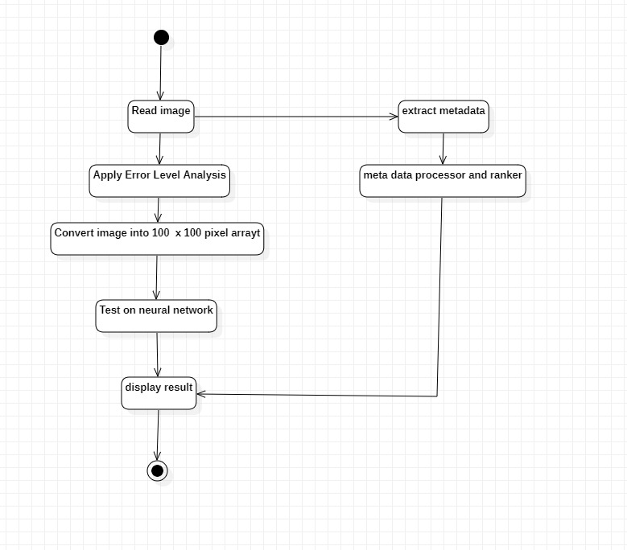
Activity Diagram

Slide 17
Sample Code
import numpy as np
import os
import cv2
from sklearn.model_selection import train_test_split
from sklearn_extensions.extreme_learning_machines.elm import GenELMClassifier
from sklearn_extensions.extreme_learning_machines.random_layer import RBFRandomLayer, MLPRandomLayer
from sklearn.metrics import accuracy_score
from numpy.linalg import norm
from numpy import dot
import imutils
files = []
filename = 'data/Fake'
label = []
for root, dirs, directory in os.walk(filename):
for i in range(len(directory)):
files.append(filename+"/"+directory[i]);
label.append(0)

Slide 18
filename = 'data/Real’
for root, dirs, directory in os.walk(filename):
for i in range(len(directory)):
files.append(filename+"/"+directory[i]);
label.append(1)
print(len(files))
X = np.ndarray(shape=(len(files), 16384), dtype=np.float32)
Y = np.ndarray(shape=(len(files)),dtype=np.float32)
print(X.shape)
print(Y.shape)
for i in range(len(files)):
img = cv2.imread(files[i])
img = cv2.cvtColor(img, cv2.COLOR_BGR2GRAY)
img = cv2.resize(img,(128,128))
img = img.reshape(-1)
X[i] = img
Y[i] = label[i]
X_train, X_test, y_train, y_test = train_test_split(X, Y, test_size = 0.1, random_state = 0)
print(X_train.shape)
print(y_train.shape)
print(y_train)

Slide 19
def prediction(X_test, cls):
y_pred = cls.predict(X_test)
for i in range(len(X_test)):
print("X=%s, Predicted=%s" % (X_test[i], y_pred[i]))
return y_pred
# Function to calculate accuracy
def cal_accuracy(y_test, y_pred):
accuracy = accuracy_score(y_test,y_pred)*100
return accuracy
def get_pixel(img, center, x, y):
new_value = 0
try:
if img[x][y] >= center:
new_value = 1
except:
pass
return new_value
def lbp_calculated_pixel(img, x, y):
center = img[x][y]
val_ar = []
val_ar.append(get_pixel(img, center, x-1, y+1)) # top_right

Slide 20
val_ar.append(get_pixel(img, center, x, y+1)) # right
val_ar.append(get_pixel(img, center, x+1, y+1)) # bottom_right
val_ar.append(get_pixel(img, center, x+1, y)) # bottom
val_ar.append(get_pixel(img, center, x+1, y-1)) # bottom_left
val_ar.append(get_pixel(img, center, x, y-1)) # left
val_ar.append(get_pixel(img, center, x-1, y-1)) # top_left
val_ar.append(get_pixel(img, center, x-1, y)) # top
power_val = [1, 2, 4, 8, 16, 32, 64, 128]
val = 0
for i in range(len(val_ar)):
val += val_ar[i] * power_val[i]
return val
srhl_tanh = MLPRandomLayer(n_hidden=500, activation_func='tanh')
cls = GenELMClassifier(hidden_layer=srhl_tanh)
cls.fit(X_train, y_train)
prediction_data = prediction(X_test, cls)
elm_acc = cal_accuracy(y_test, prediction_data)
print(elm_acc)
img_bgr = cv2.imread('testimages/fake.jpg')
height, width, channel = img_bgr.shape
img_gray = cv2.cvtColor(img_bgr, cv2.COLOR_BGR2GRAY)
img_lbp = np.zeros((height, width,3), np.uint8)
for i in range(0, height):

Slide 21
for j in range(0, width):
Img_lbp[i, j] = lbp_calculated_pixel(img_gray, i, j)
cv2.imwrite('test.jpg', img_lbp)
img1 = cv2.imread('test.jpg')
img1 = cv2.resize(img,(128,128))
img1 = img1.reshape(-1)
y_pred = cls.predict(img1)
print(len(y_pred))
print(y_pred)
img_bgr = cv2.imread('testimages/real.jpg')
height, width, channel = img_bgr.shape
img_gray = cv2.cvtColor(img_bgr, cv2.COLOR_BGR2GRAY)
img_lbp = np.zeros((height, width,3), np.uint8)
for i in range(0, height):
for j in range(0, width):
img_lbp[i, j] = lbp_calculated_pixel(img_gray, i, j)
cv2.imwrite('test1.jpg', img_lbp)
img1 = cv2.imread('test1.jpg')
img1 = cv2.resize(img,(128,128))
img1 = img1.reshape(-1)
y_pred = cls.predict(img1)
print(len(y_pred))
print(y_pred)

Slide 22
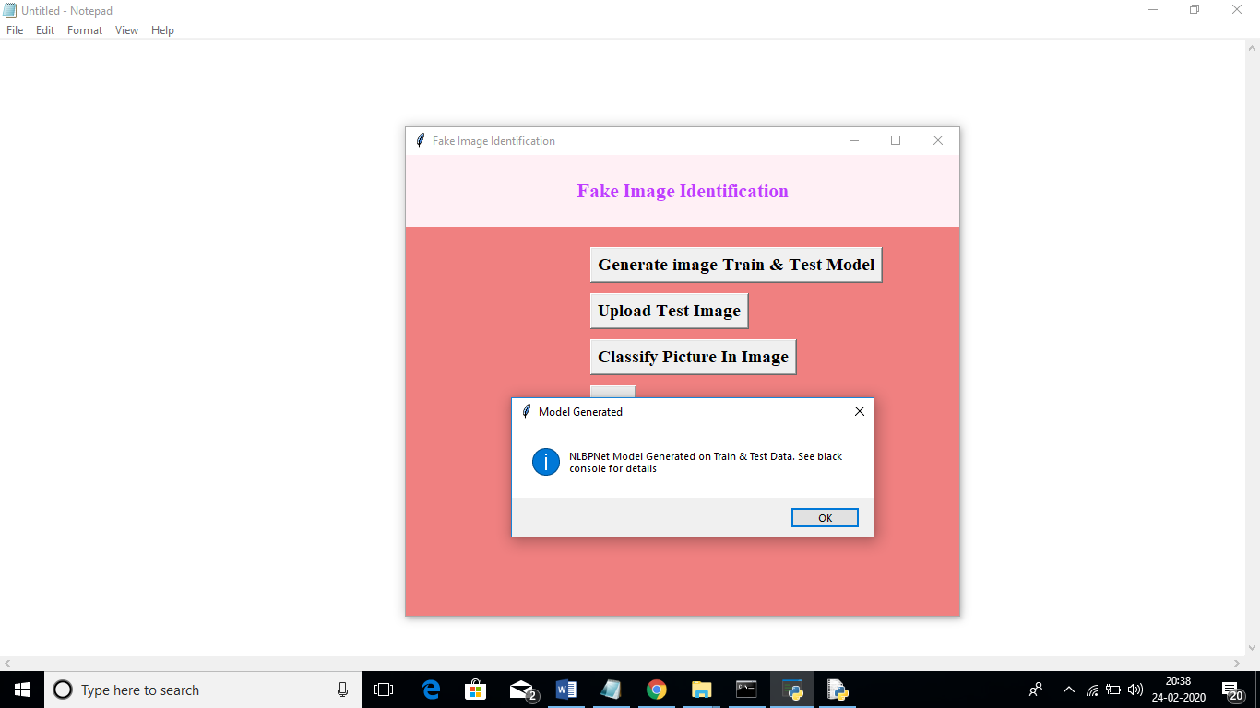
Results
In above screen click on ‘Generate Image Train & Test Model’ button to generate CNN model using LBP images contains inside LBP folder.

Slide 23
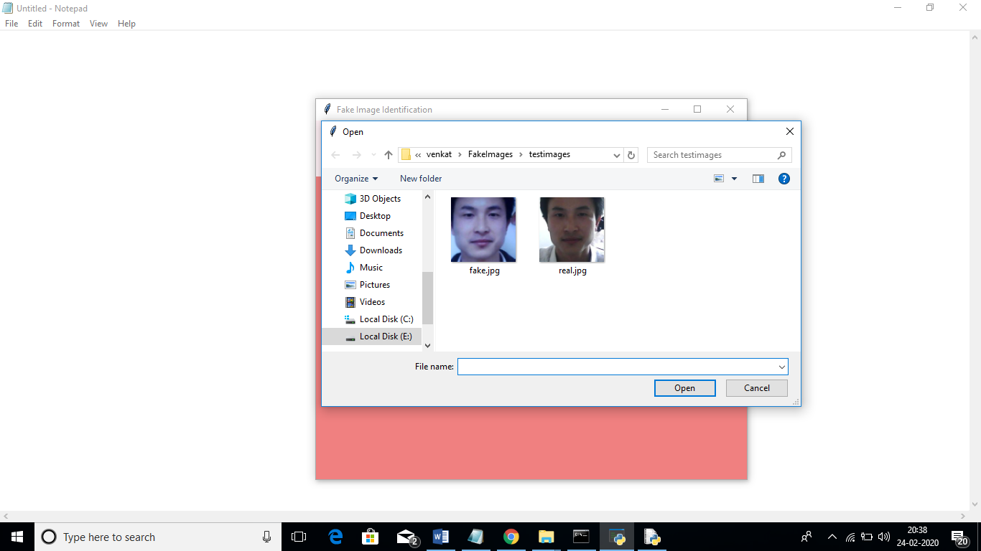
In above screen we can see two faces are there from same person but in different appearances. For simplicity I gave image name as fake and real to test whether application can detect it or not. In above screen I am uploading fake image and then click on ‘Classify Picture In Image’ button to get below result

Slide 24

In above screen we can see all real face will have normal light and in fake faces peoples will try some editing to avoid detection but this application will detect whether face is real or fake

Slide 25
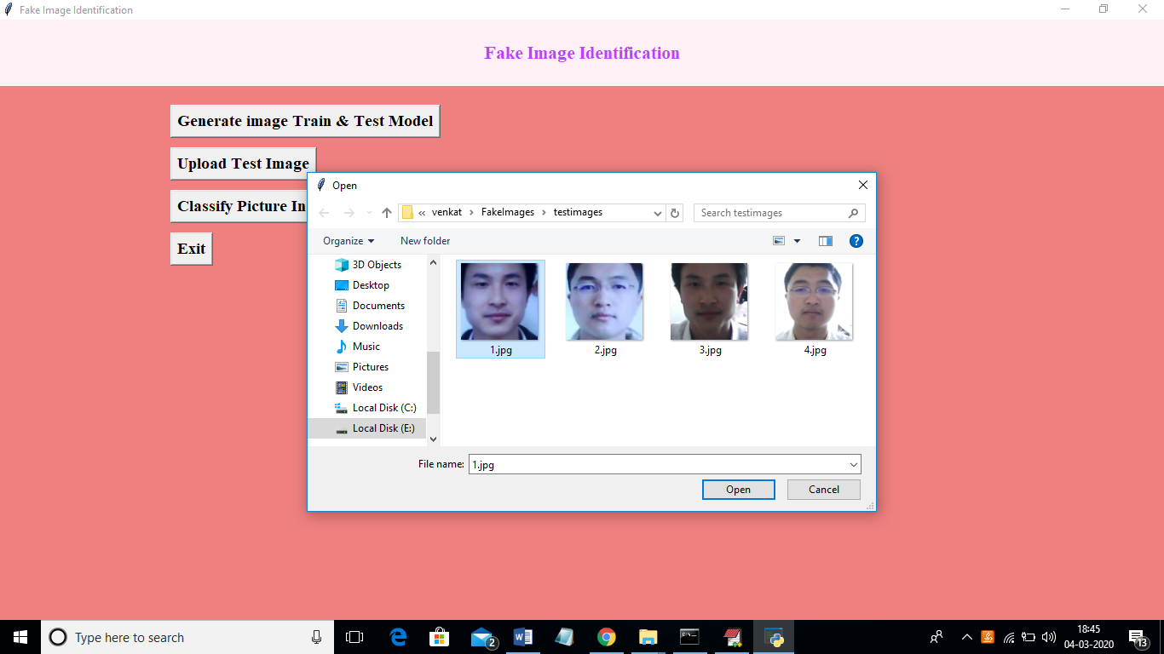
In above screen I am uploading 1.jpg and after upload click on open button to get below screen

Slide 26
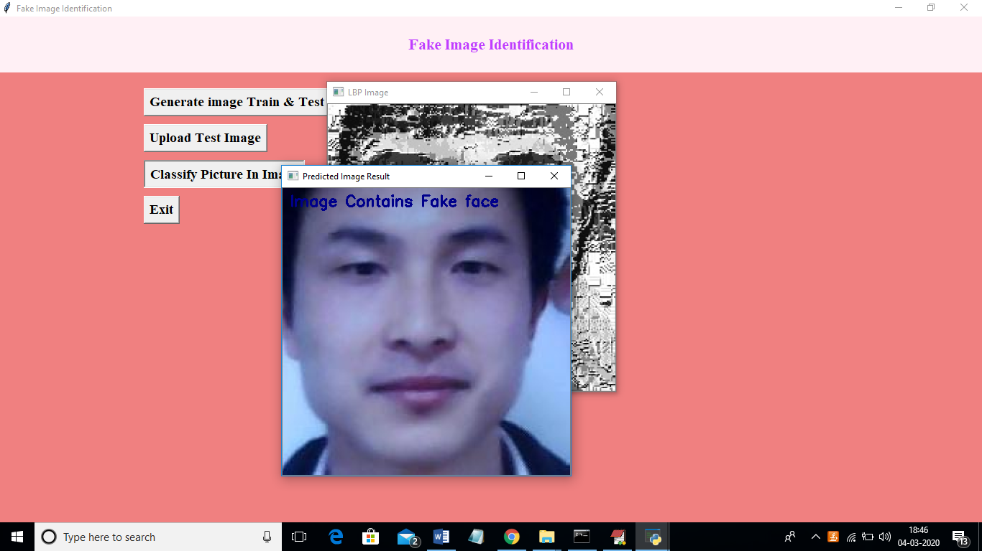
In above screen we are getting result as image contains Fake face. Similarly u can try other images also. If u want to try new images then u need to send those new images to us so we will make CNN model to familiar with new images so it can detect those images also.

Slide 27
Conclusion:
Fake image detection using deep learning has gained significant attention in recent years due to the increasing prevalence of manipulated images in social media and other online platforms. Another important aspect of fake image detection is the availability of large and diverse datasets. The availability of such datasets is essential for training deep learning models and improving their performance. However, creating such datasets is a challenging task, and more research is needed in this area.
In conclusion, deep learning techniques have shown great potential in detecting fake images, but more research is needed to address the challenges in this field, such as dataset availability and the detection of more sophisticated fake images.

Slide 28
Future Scope
The future of fake image detection using deep learning is characterized by ongoing advancements in sophisticated models, multi-modal approaches combining text and image analysis, specialized detection techniques for deepfakes and GAN-generated content, real-time detection solutions, and increased focus on ethical considerations. This field's applications across diverse industries, potential regulatory developments, and interdisciplinary collaborations make it a promising area for research and innovation, as the need to combat fake content and misinformation remains a pressing global challenge.

Slide 29
References
1. Karras, T.; Aila, T.; Laine, S.; Lehtinen, J. Progressive growing of gans for improved quality, stability, and variation. arXiv Preprint, arXiv:1710.10196 2017. 256
2. Brock, A.; Donahue, J.; Simonyan, K. Large scale gan training for high fidelity natural image synthesis. arXiv Preprint, arXiv:1809.11096 2018.
3. Zhu, J.Y.; Park, T.; Isola, P.; Efros, A.A. Unpaired image-to-image translation using cycle-consistent 259 adversarial networks. arXiv Preprint, 2017.
4. AI can now create fake porn, making revenge porn even more complicated,. http://theconversation.com/ai-can-now-create-fake-porn-making-revenge-porn-even-more-complicated-92267, 262 2018.
5. Hsu, C.; Lee, C.; Zhuang, Y. Learning to detect fake face images in the Wild. 2018 International Symposium 264 on Computer, Consumer and Control (IS3C), 2018, pp. 388–391. doi:10.1109/IS3C.2018.00104.

Slide 30
6. H.T. Chang, C.C. Hsu, C.Y.a.D.S. Image authentication with tampering localization based on watermark 266 embedding in wavelet domain. Optical Engineering 2009, 48, 057002.
7. Hsu, C.C.; Hung, T.Y.; Lin, C.W.; Hsu, C.T. Video forgery detection using correlation of noise residue. Proc. of the IEEE Workshop on Multimedia Signal Processing. IEEE, 2008, pp. 170–174.
8. Farid, H. Image forgery detection. IEEE Signal Processing Magazine 2009, 26, 16–25.
9. Huaxiao Mo, B.C.; Luo, W. Fake Faces Identification via Convolutional Neural Network. Proc. of the ACM Workshop on Information Hiding and Multimedia Security. ACM, 2018, pp. 43–47.
10. Marra, F.; Gragnaniello, D.; Cozzolino, D.; Verdoliva, L. Detection of GAN-Generated Fake Images over Social Networks. Proc. of the IEEE Conference on Multimedia Information Processing and Retrieval, 2018, 274 pp. 384–389. doi:10.1109/MIPR.2018.00084.
11. Chollet, F. Xception: Deep learning with depthwise separable convolutions. Proc. of the IEEE conference on 276 Computer Vision and Pattern Recognition 2017, pp. 1610–02357.

Slide 31
THANK YOU

